Slide 1

Pemrograman perangkat bergerak
Dosen :
MUHAMMAD NASHRULLAH

Slide 2
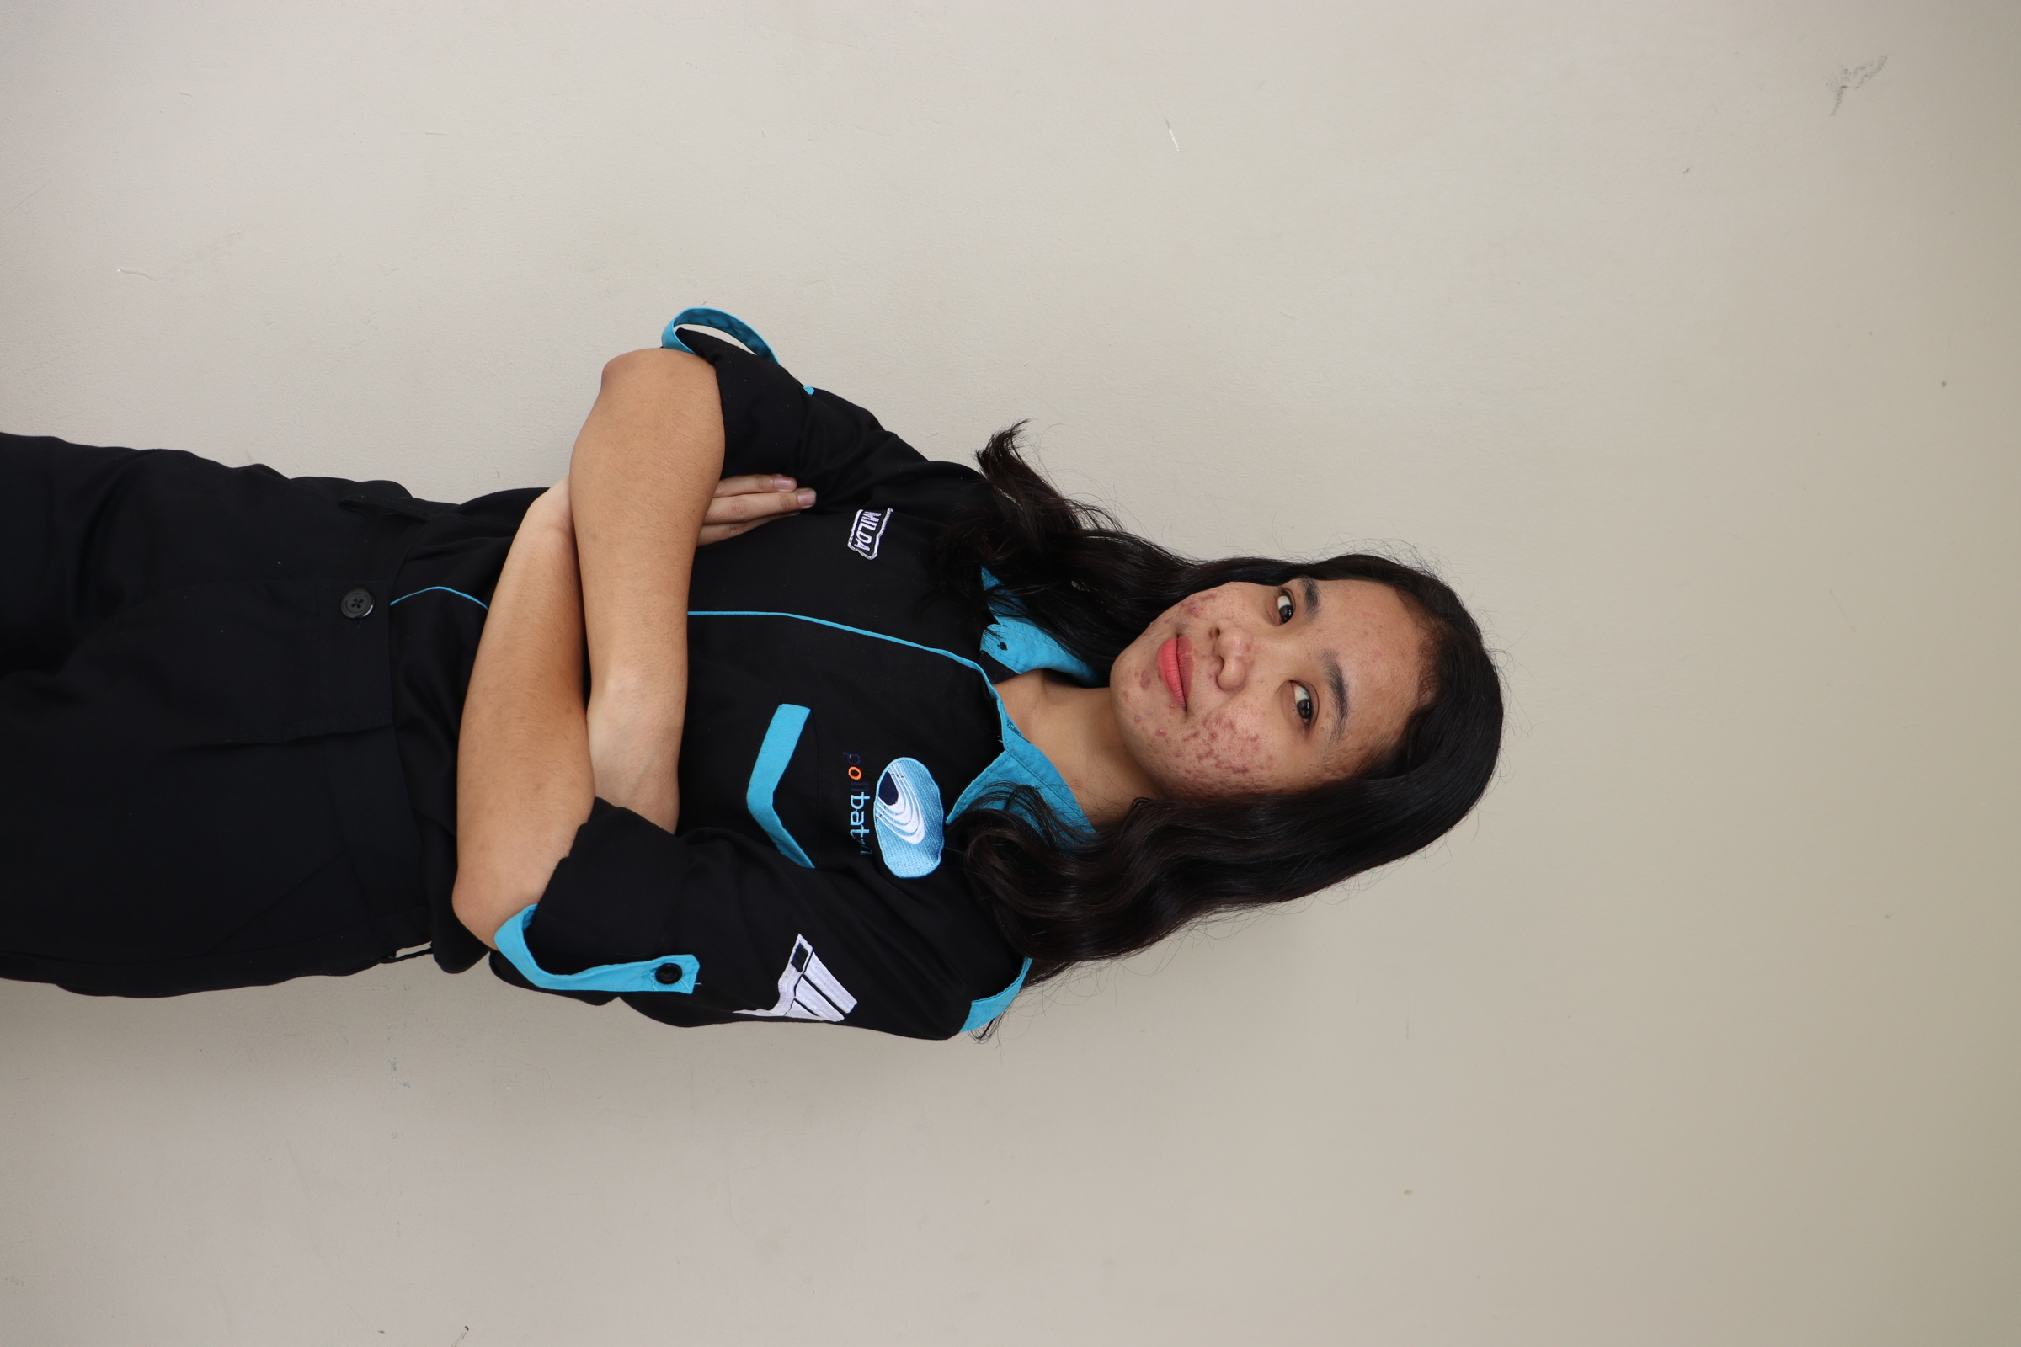
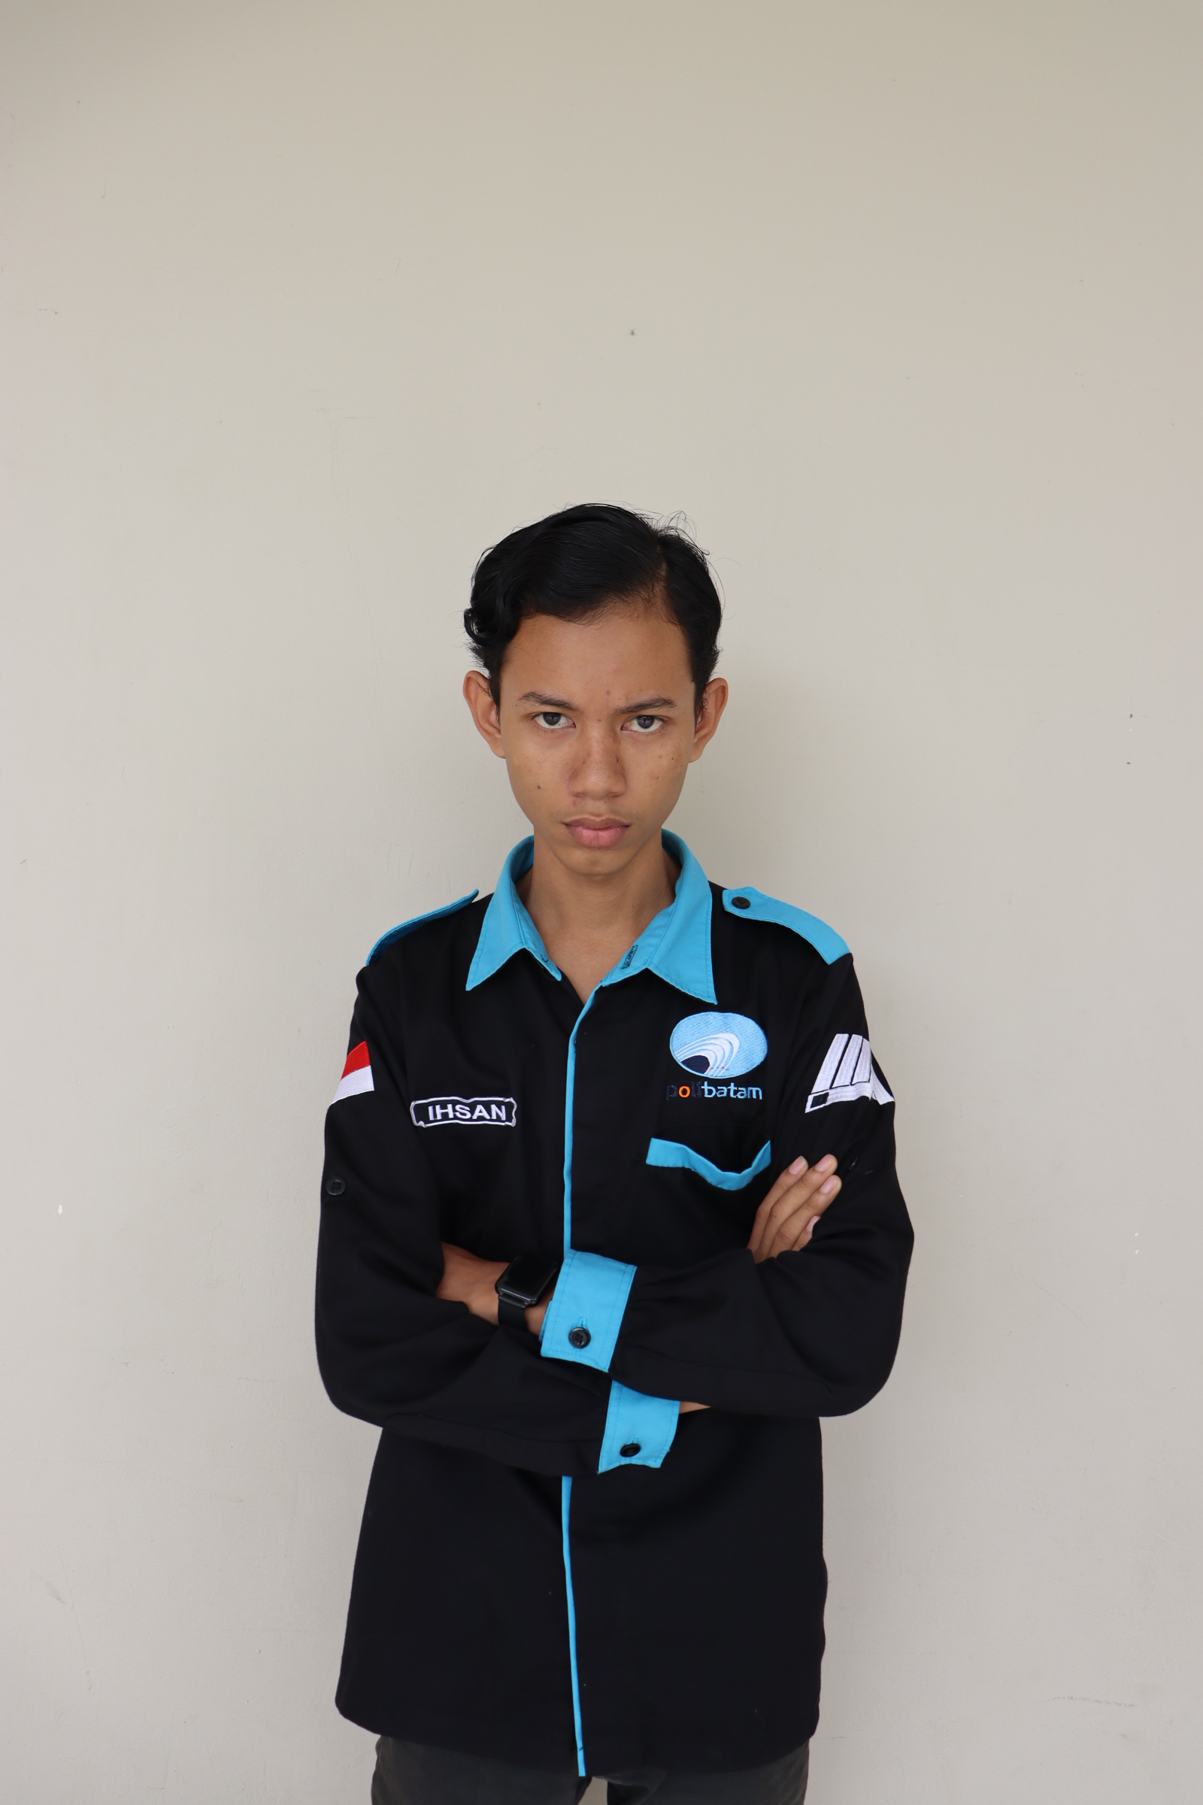
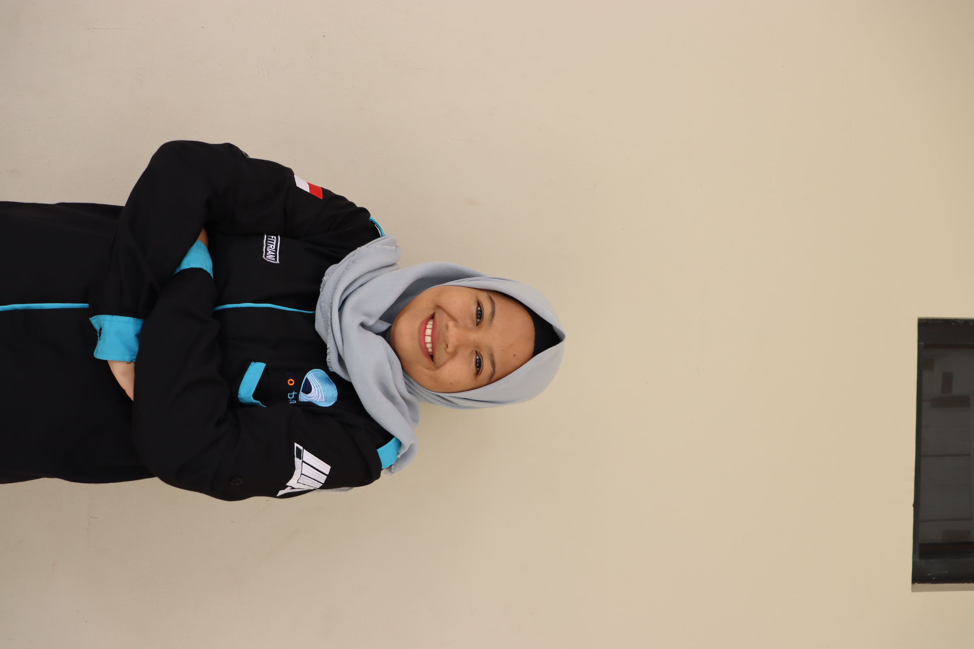
TEAM’S MEMBER
Tania Milda Grasella
Muhammad Ihsan
Lintang Fitriani Pamungkas
4311801020
4311801024
4311801029

Slide 3
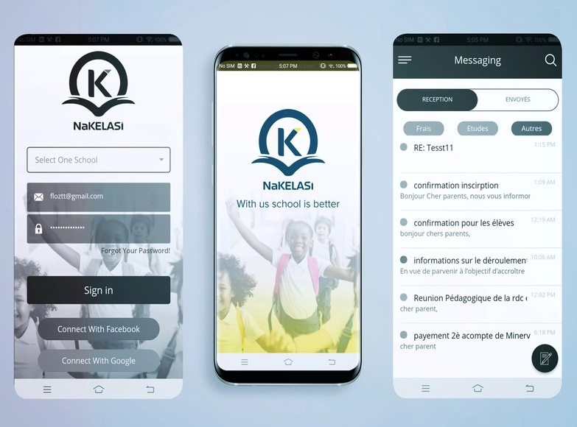
DESIGN DAN LINK ACUAN
https://dribble.com/shots/5853806-Ionic-3-Ui-Theme-Template-App

Slide 4

FRONTEND
HALAMAN AWAL (1)
<ion-button expand="block" color="medium" (click)="navigateToSignIn()"
>Mulai Membaca</ion-button>

Slide 5

FRONTEND
HALAMAN AWAL (2)
<ion-slides pager="true" [options]="slideOpts">
<ion-slide>
<app-logo></app-logo>
<h2>Selamat Datang!</h2>
<p>Tingkatkan minat bacamu untuk masa depan yang lebih baik</p>
</ion-slide>
<ion-slide>
<img
src="assets/images/illustration.png"
alt="KUYBACA"
class="welcomeImage"
/>
<h3>Ubah Bangsa Lewat Membaca</h3>
<p>Tekan Mulai Yuk!</p>
</ion-slide>
</ion-slides>

Slide 6
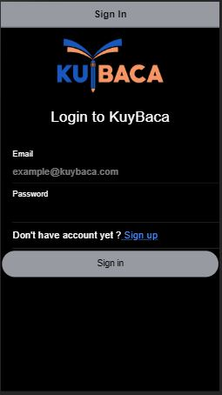
FRONTEND
HALAMAN LOGIN
<ion-header>
<ion-toolbar color="medium">
<ion-title>Sign In</ion-title>
</ion-toolbar>
</ion-header>
<ion-content padding="true">
<div class="center">
<app-logo></app-logo>
<h1>Login to KuyBaca</h1>
</div>
<form>
<ion-list>
<ion-item>
<ion-label position="stacked">Email</ion-label>
<ion-input type="email" placeholder="example@kuybaca.com"></ion-input>
</ion-item>
<ion-item>
<ion-label position="stacked">Password</ion-label>
<ion-input type="password"></ion-input>
</ion-item>
<ion-item>
Don't have account yet ?<a routerLink="/signup">&nbsp;Sign up</a>
</ion-item>
<ion-button expand="block" shape="round" color="medium" (click)="signin()"
>Sign in
</ion-button>
</ion-list>
</form>
</ion-content>

Slide 7
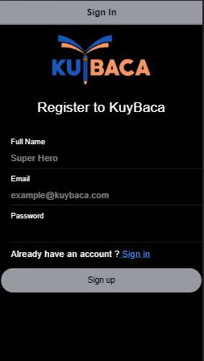
FRONTEND
HALAMAN REGISTER
<ion-header>
<ion-toolbar color="medium">
<ion-title>Sign In</ion-title>
</ion-toolbar>
</ion-header> <ion-content padding="true">
<div class="center">
<app-logo></app-logo>
<h1>Register to KuyBaca</h1>
</div> <form>
<ion-list>
<ion-item>
<ion-label position="stacked">Full Name</ion-label>
<ion-inpAut type="text" placeholder="Super Hero"></ion-input>
</ion-item>
<ion-item>
<ion-label position="stacked">Email</ion-label>
<ion-input type="email" placeholder="example@kuybaca.com"></ion-input>
</ion-item>
<ion-item>
<ion-label position="stacked">Password</ion-label>
<ion-input type="password"></ion-input>
</ion-item> <ion-item lines="none">
Already have an account ?<a routerLink="/signin">&nbsp;Sign in</a>
</ion-item> <ion-button expand="block" shape="round" color="medium" (click)="signup()"
>Sign up
</ion-button>
</ion-list>
</form>
</ion-content>

Slide 8

FRONTEND
HALAMAN DASHBOARD
<ion-header>
<ion-toolbar color="medium">
<ion-title>Dashboard</ion-title>
</ion-toolbar>
</ion-header> <ion-content>
<ion-card>
<ion-card-content class="resize">
<img src="assets/images/dilan1991.jpg" alt="Dilan 1991"
/></ion-card-content>
<ion-card-header>
<ion-card-subtitle>Pastel Books (Mizan Group)</ion-card-subtitle>
<ion-card-title>Dilan 1991</ion-card-title>
</ion-card-header> <ion-card-content>
Dia adalah Dilanku tahun 1991 adalah sebuah novel karya Pidi Baiq.
</ion-card-content>
</ion-card>

Slide 9
<ion-card>
<ion-card-content class="resize">
<img src="assets/images/hujan.jpg" alt="Hujan"
/></ion-card-content>
<ion-card-header>
<ion-card-subtitle>Gramedia Pustaka Utama</ion-card-subtitle>
<ion-card-title>Hujan</ion-card-title>
</ion-card-header> <ion-card-content>
Berkisah tentang persahabatan, tentang cinta, tentang perpisahan, tentang
melupakan, dan tentang hujan.
</ion-card-content>
</ion-card> <ion-card>
<ion-card-content class="resize">
<img src="assets/images/koalakumal.jpg" alt="Koala Kumal"
/></ion-card-content>
<ion-card-header>
<ion-card-subtitle>GagasMedia</ion-card-subtitle>
<ion-card-title>Koala Kumal</ion-card-title>
</ion-card-header> <ion-card-content>
Novel Koala kumal ini bercerita tentang patah hati, dari seorang Dika yang
masih SD kemudian ketika SMA sampai ia mahasiswa.
</ion-card-content>
</ion-card> <ion-fab vertical="bottom" horizontal="end" slot="fixed">
<ion-fab-button color="medium">
<ion-icon name="add"></ion-icon>
</ion-fab-button>
</ion-fab>
</ion-content>

Slide 10
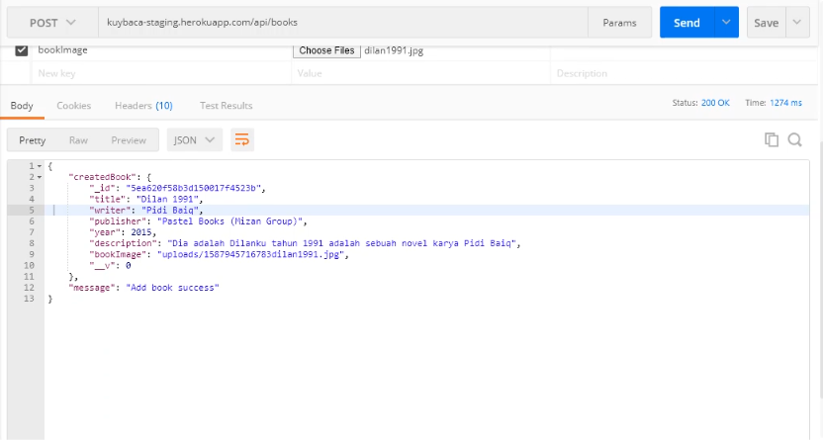
BACKEND
TAMPILAN POST

Slide 11
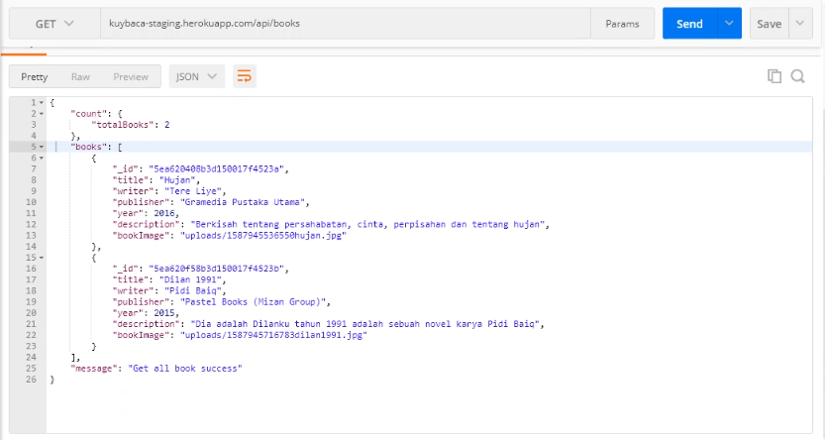
BACKEND
TAMPILAN GET

Slide 12
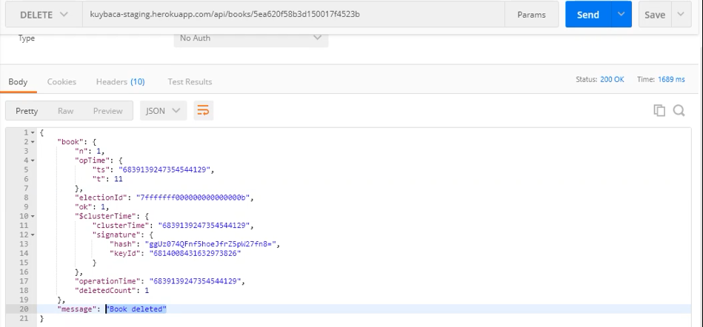
BACKEND
TAMPILAN DELETE

Slide 13
T E R I M A K A S I H

